Slide 1




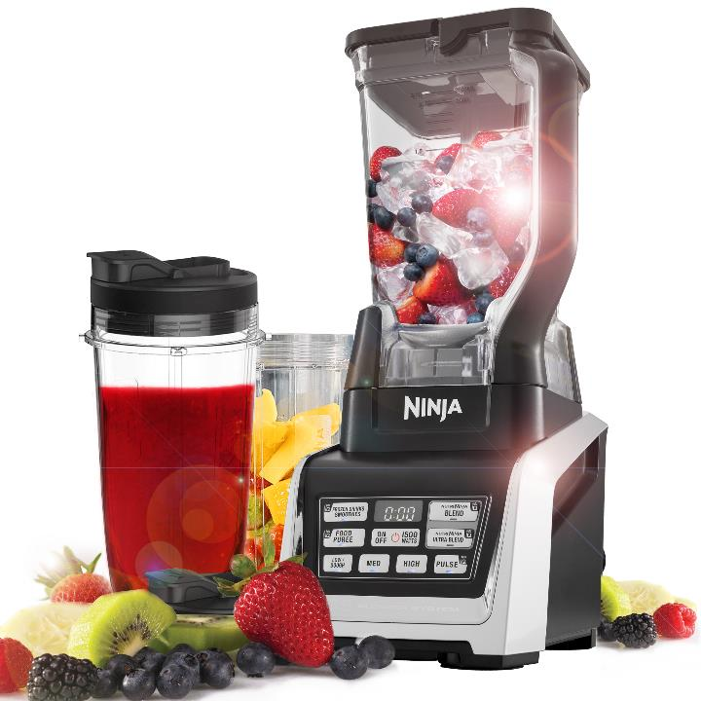
Model Number | BL642UK
Product Description | NutriNinja Duo Blender
Technology | Auto iQ Technology Two functions from 1 base – Nutri & Blender
Wattage | 1500W
Manual Programs | 4 – Low/Dough, Med, High and Pulse
Auto iQ Programs | 4 - Nutri Ninja Blend, Nutri Ninja Ultra Blend, Food Puree and Frozen Drinks & Smoothies
Accessories | 1500w Motor Base 1 x 2.1L Pitcher & Lid 1 x Total Crushing Blade 1 x 500ml Tritan Ninja Cup 1 x 650ml Tritan Ninja Cup 1 x 900ml Tritan Ninja Cup 3 x Sip & Seal Lids 1 x Pro Extractor Blades
Features | Auto-iQ – One Touch Technology Nutrient & Vitamin Extraction Pro Extractor Blades breaks down whole fruits, vegetables, ice & seeds for refreshing full bodied nutritious juices. Ideal for on the go drinks or larger batches if you have guests over.
Guarantee | 1 year

Slide 2
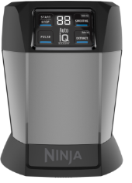



XMBBL580BUKV | 1000W Motor Base - BL580UKV
3940K580UKV | 700ml Single Serve Cup (no lid)
3941K580UKV | Pro Extractor Blades - BL580UKV
3942K580UKV | Spout Lid - BL580UKV
Upsell Options – Cups and Lids

Slide 3
XMBBL580BUKV | 1000W Motor Base - BL580UKV
3940K580UKV | 700ml Single Serve Cup (no lid)
3941K580UKV | Pro Extractor Blades - BL580UKV
3942K580UKV | Spout Lid - BL580UKV
Upsell Options – food processor bowl and accessories
Needs checking – had Y in the master spreadsheet.

Slide 4
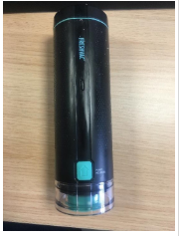
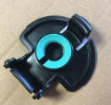
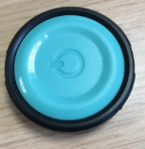
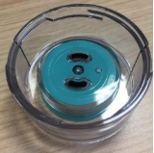
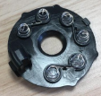
3949K580UKV | Vacuum Pump (unit)
3951K580UKV | Flip & Seal Cup Lid
3954K580UKV | Vac Pump Button
3955K580UKV | Vacuum Reservoir
3956K580UKV | Battery Conductor
3949K580UKV | Vacuum Pump (unit)
3951K580UKV | Flip & Seal Cup Lid
3954K580UKV | Vac Pump Button
3955K580UKV | Vacuum Reservoir
3956K580UKV | Battery Conductor
Replacement Parts

