Slide 1



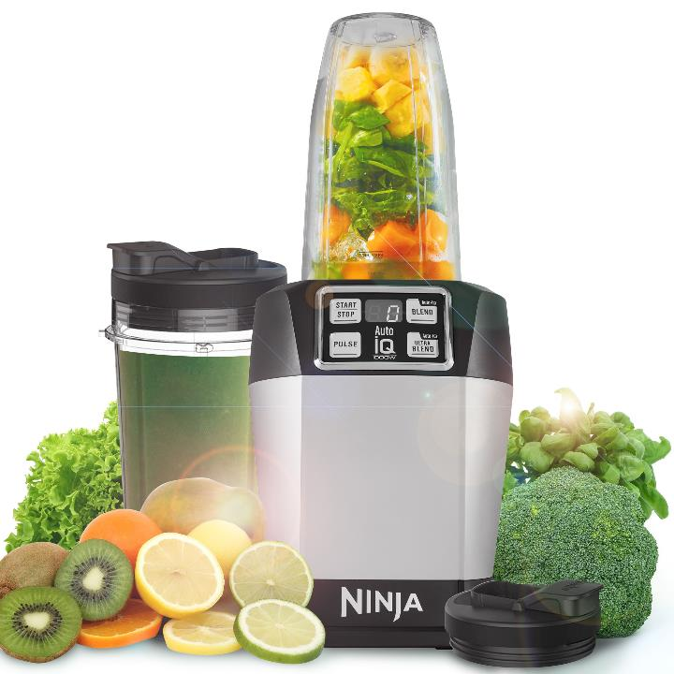
Model Number | BL480UK
Product Description | NutriNinja with Auto IQ
Technology | Auto iQ Technology
Wattage | 1000W
Cup Capacity | 0.5 and 0.65 Litre
Manual Programs | 2 – Pulse & Start/Stop
Auto iQ Programs | 2 – Blend & Ultra Blend
Accessories | 1000w Motor Base 1 x 500ml Tritan Ninja Cup 1 x 650ml Tritan Ninja Cup 2 x Sip & Seal Lids 1 x Pro Extractor Blades
Features | Auto-iQ – One Touch Technology Nutrient & Vitamin Extraction Pro Extractor Blades breaks down whole fruits, vegetables, ice & seeds for refreshing full bodied nutritious juices. Ideal for making tasty single-serve recipes including smoothies, milkshakes, dips, dressings, soups etc.
Guarantee | 1 year

Slide 2
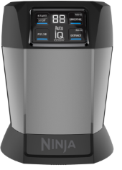



XMBBL580BUKV | 1000W Motor Base - BL580UKV
3940K580UKV | 700ml Single Serve Cup (no lid)
3941K580UKV | Pro Extractor Blades - BL580UKV
3942K580UKV | Spout Lid - BL580UKV
Upsell Options

Slide 3
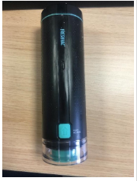
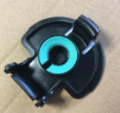
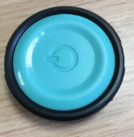
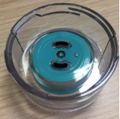
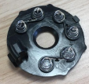
3949K580UKV | Vacuum Pump (unit)
3951K580UKV | Flip & Seal Cup Lid
3954K580UKV | Vac Pump Button
3955K580UKV | Vacuum Reservoir
3956K580UKV | Battery Conductor
3949K580UKV | Vacuum Pump (unit)
3951K580UKV | Flip & Seal Cup Lid
3954K580UKV | Vac Pump Button
3955K580UKV | Vacuum Reservoir
3956K580UKV | Battery Conductor
Replacement Parts

