Slide 3
Waterproof casing
WiFi on X4, X6,
future models
At least 1.5 hour record time
X6 Best Reviewed on Kieskeurig July 2016

Slide 4
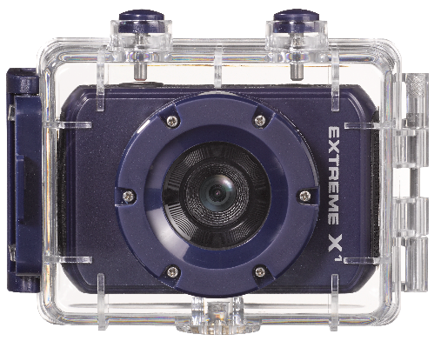
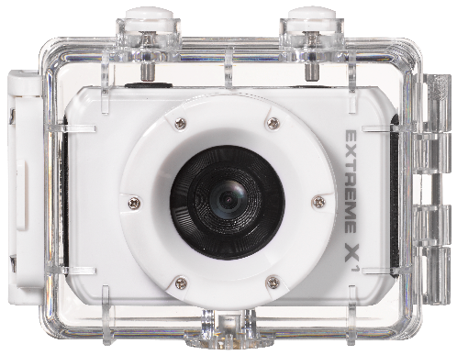
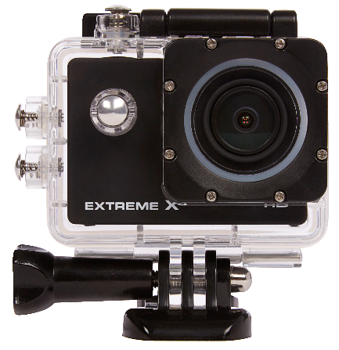
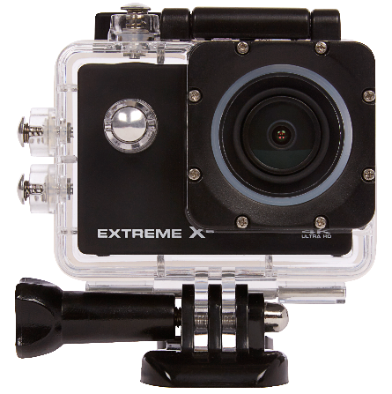
AN ACTION CAM FOR EVERY AGE
X1B
X1W
X2
X4
X6
December ´16

Slide 5
TARGET GROUP
Youngsters
Extreme Sporters
People interested in Action Cam
Age 10 – 45
Active lifestyle
Shares his/her adventures online

Slide 7
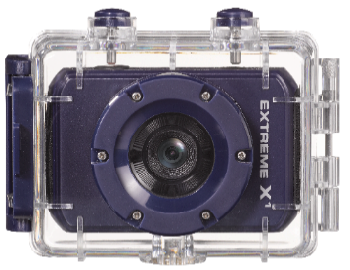
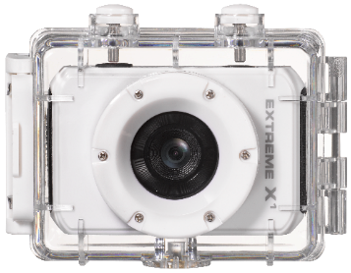
1
Your first Action Cam
720P HD ready
Underwater casing
1,5 hour record time
2 colours
Accessorypack
SRP: €39,95
2
Expected launchdate: December ‘16
Your first Action Cam
720P HD ready
Underwater casing
1,5 hour record time
Accessorypack
Works with ExtremeX battery pack
SRP: €49,95

Slide 8
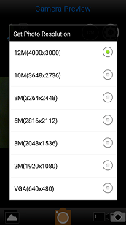
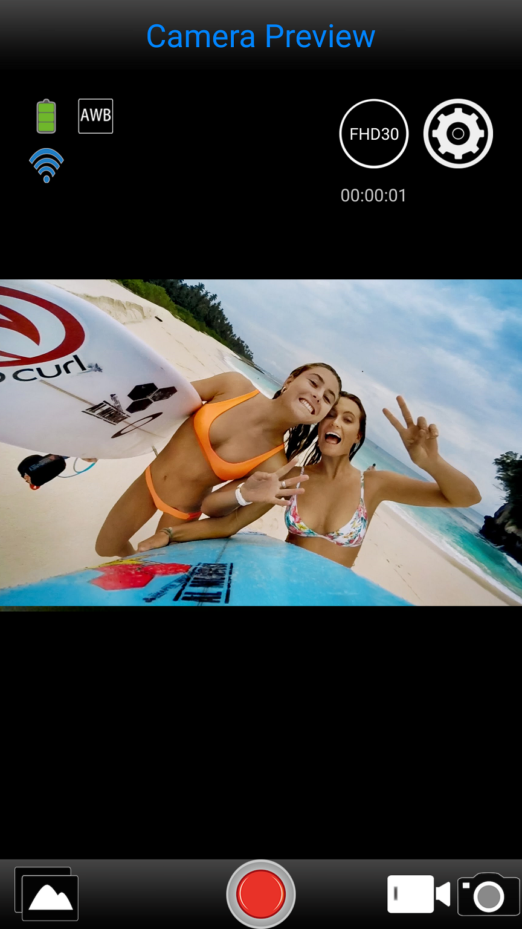
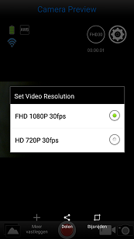
4
Your first Full HD – WiFi Action Cam
1080P HD – 30FPS
WiFi, App controllable (App: Isportcam)
Underwater casing
1,5 hour record time
Accessorypack
Works with ExtremeX battery pack
SRP: €79,95

Slide 9
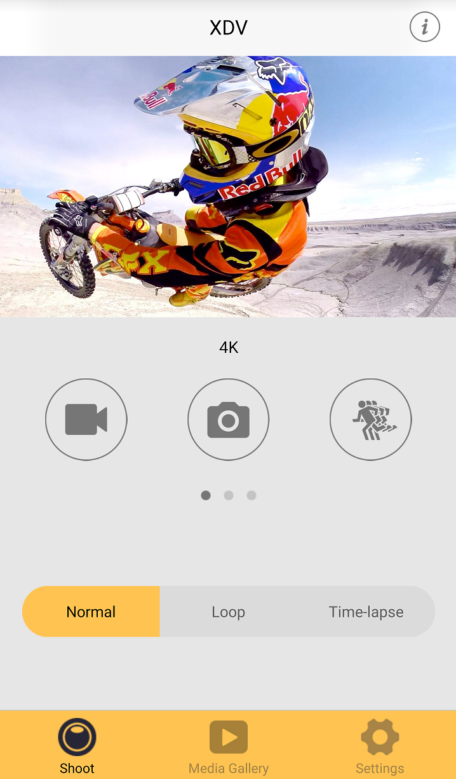
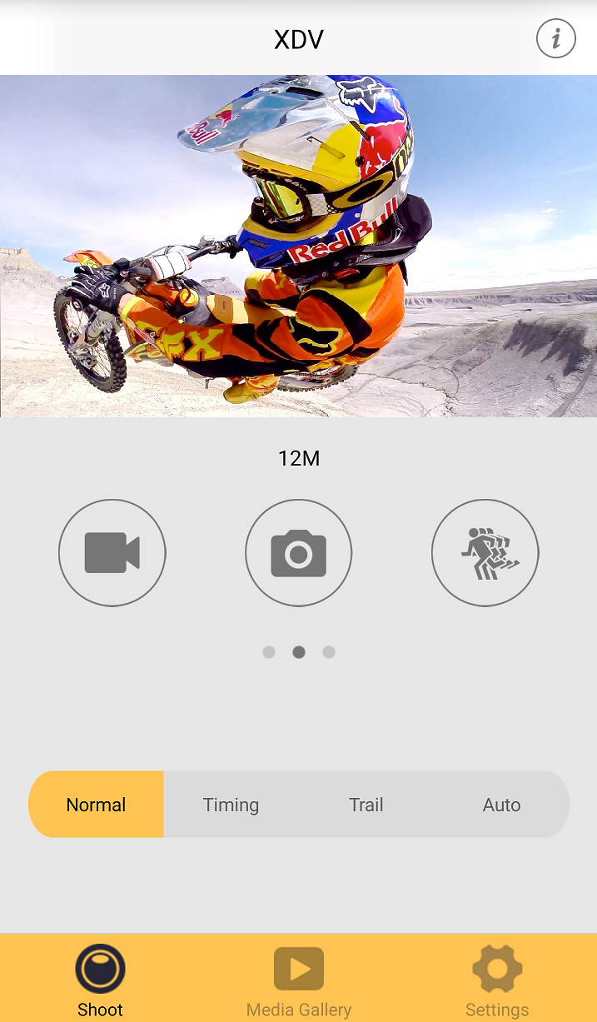
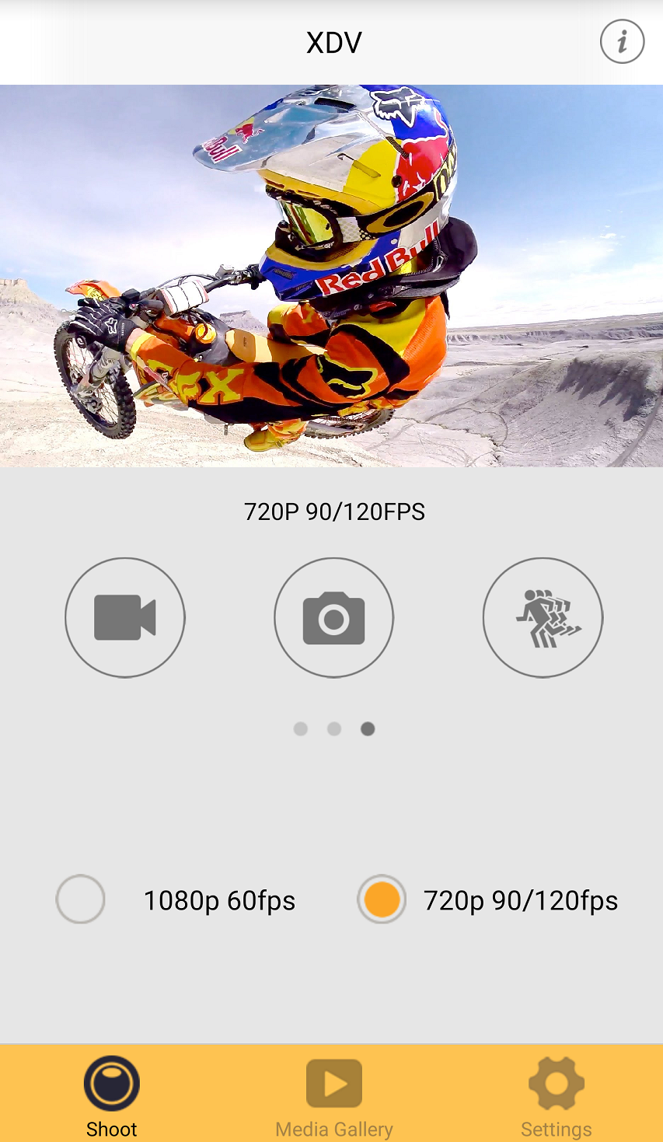
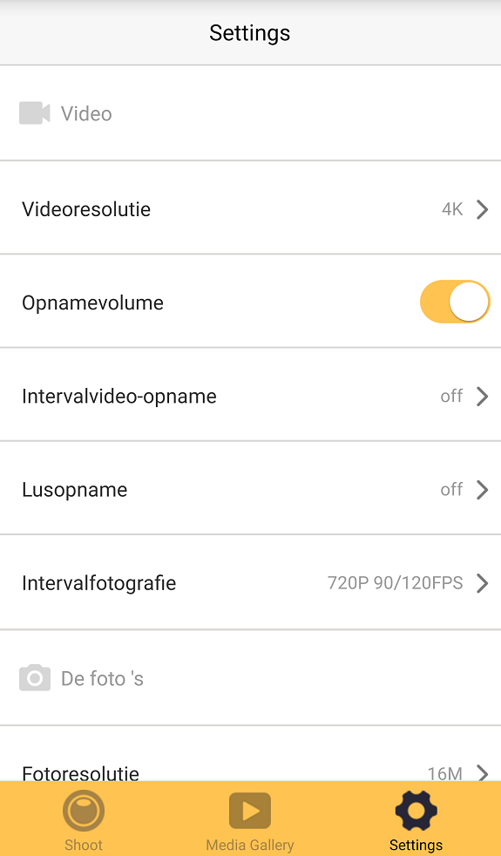
6
Your partner in Action
4K – 30FPS
1080P – 60FPS
WiFi, App controllable (App: XDV – App)
Underwater casing
1,5 hour record time
Accessorypack
Works with ExtremeX battery pack
SRP: €119,95

Slide 10
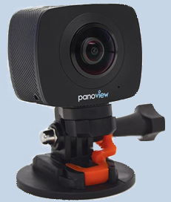
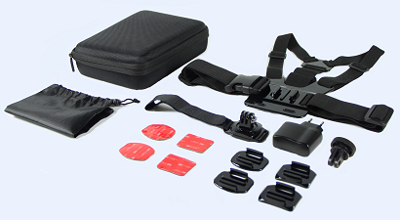
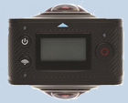
ExtremeXpowerpack:
Spare battery X2, X4, X6 SRP: €19,95
BUILDING THE BRAND
Accessorypack:
Nikkei ExtremeX Accessorypack
GoPro compatible.
Accessorypack 2
Launchdate:
December / Q1 - 2017
ExtremeX360:
Nikkei ExtremeX 360 cam
Launchdate:
December / Q1 - 2017

