Slide 1
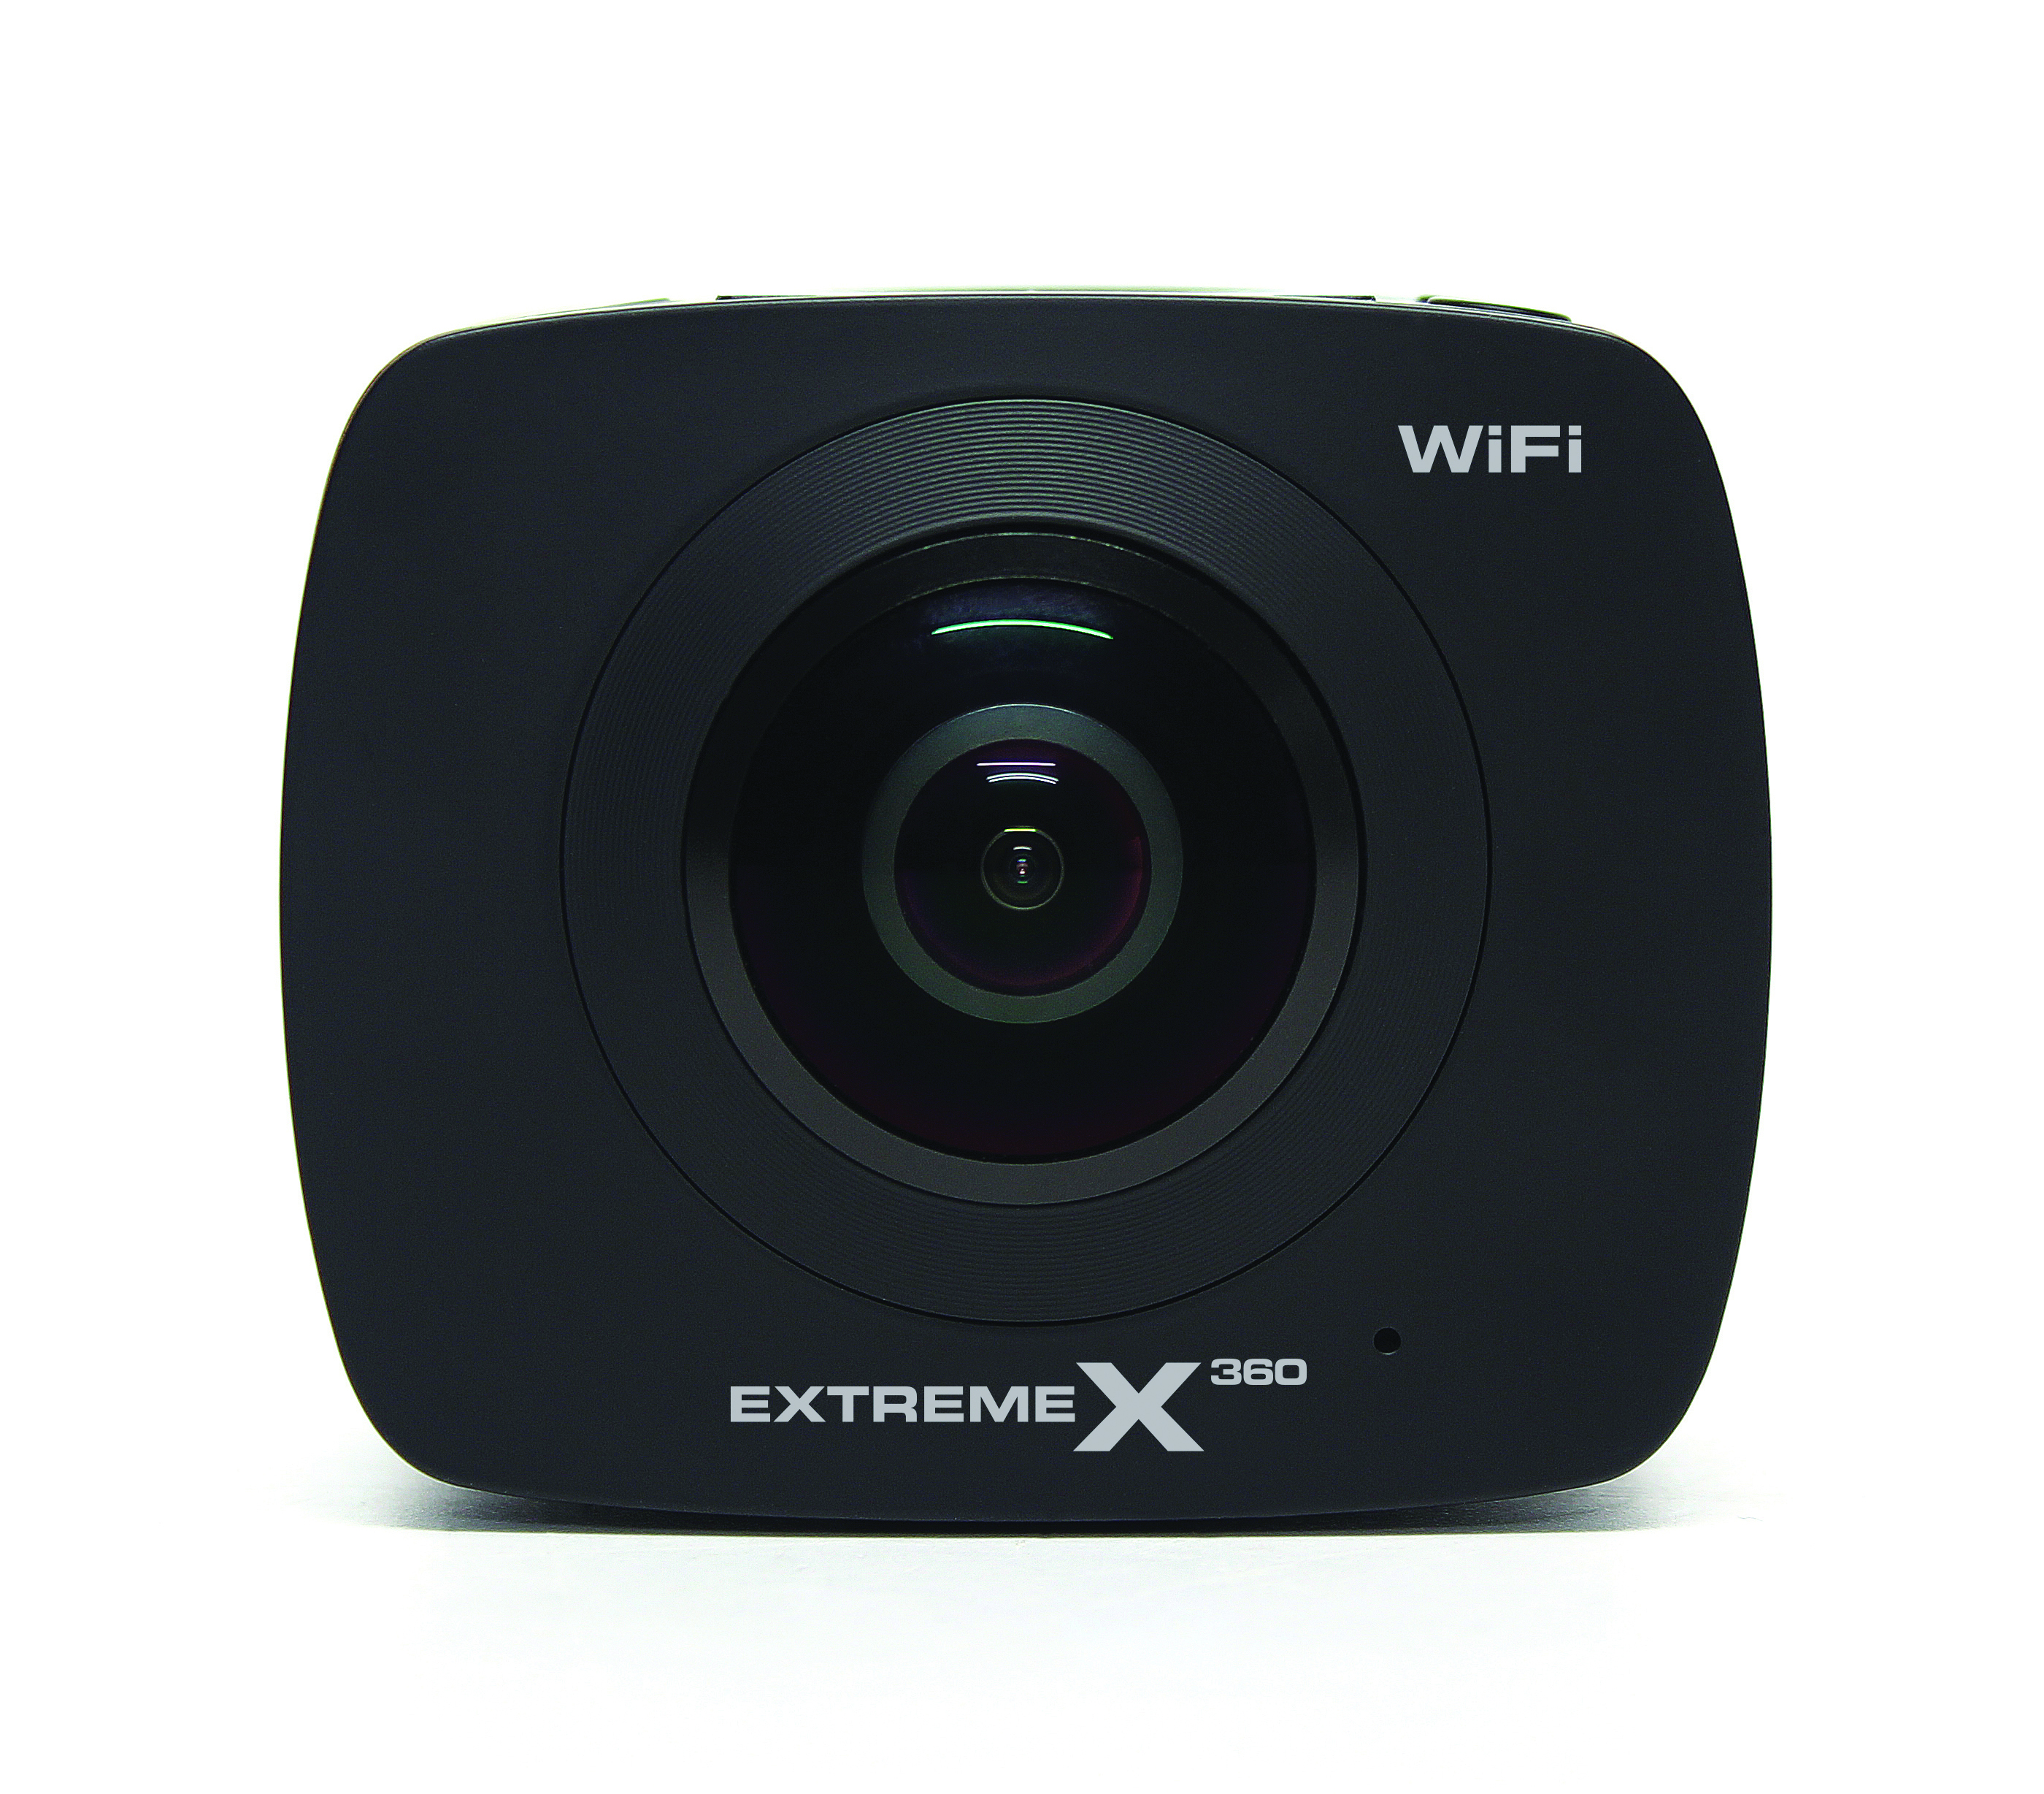
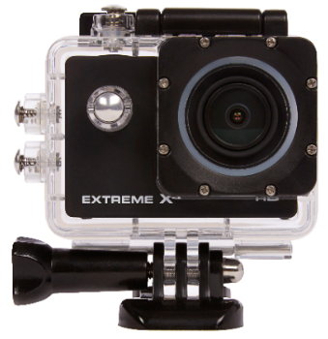
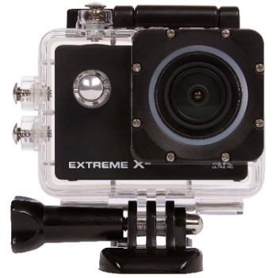
ExtremeX2
ExtremeX4
ExtremeX6
ExtremeX360
Resolution: |  | 720P HD - 30 FPS |  | 1080P Full HD - 30FPS |  | 4K - 30FPS
 |  |  |  | 720P HD - 30 FPS |  | 1080P Full HD - 60FPS
 |  |  |  |  |  | 720P HD - 120 FPS
WiFi: |  |  |  | WiFi, app: iSportcam |  | WiFi, app: XDV
Casing: |  | Underwater house |  | Underwater house |  | Underwater house
Battery life: |  | Record time 1,5 hour |  | Record time 1,5 hour |  | Record time 1,5 hour
Accessory: . |  | GoPro compatible accessories included |  | GoPro compatible accessories included |  | GoPro compatible accessories included
 |  | SRP: €49,95 |  | SRP: €79,95 |  | SRP: €119,95
Full HD 2x 960P - 30FPS
WiFi, app: ExtremeX360
Record time 1,2 hour
GoPro compatible accessories included
SRP: €249,95

Slide 2
ExtremeX2
ExtremeX4
ExtremeX6
ExtremeX360
 |  | 720P HD - 30 FPS |  | 1080P Full HD - 30FPS |  | 4K - 30FPS
 |  |  |  | 720P HD - 30 FPS |  | 1080P Full HD - 60FPS
 |  |  |  |  |  | 720P HD - 120 FPS
 |  |  |  | WiFi geïntegreerd |  | WiFi geïntegreerd
 |  | 120˚ beeldhoek |  | 170˚ beeldhoek |  | 170˚ beeldhoek
 |  | Record time 1,5 hour |  | Record time 1,5 hour |  | Record time 1,5 hour
. |  | GoPro compatible accessories included |  | GoPro compatible accessories included |  | GoPro compatible accessories included
 |  | €49,95 |  | €79,95 |  | €119,95
Full HD 2x 960P - 30FPS
WiFi geïntegreerd
360˚ beeldhoek (2 x 220˚)
Record time 1,2 hour
GoPro compatible accessories included
€249,95

