Slide 1
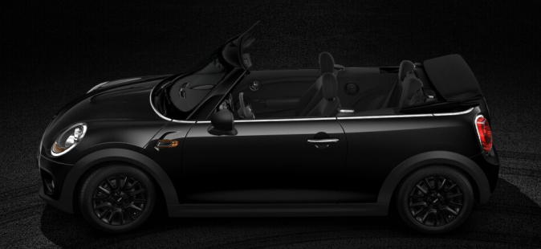
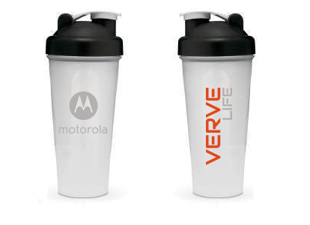
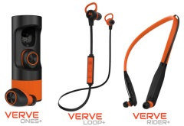
MSH VERVE INTRODUCTION PLAN

Slide 2
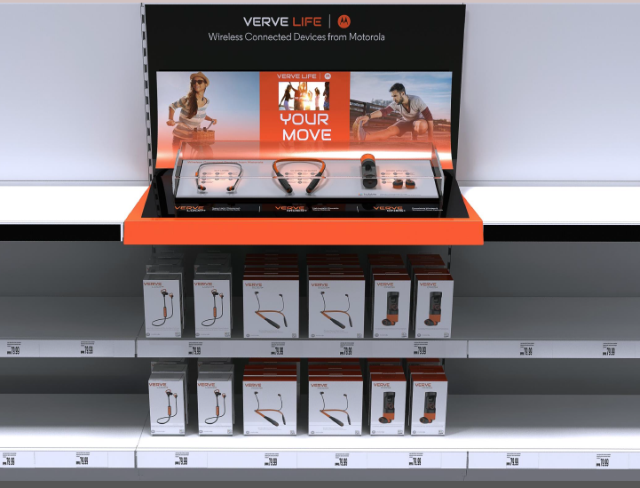
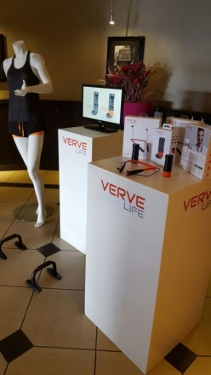
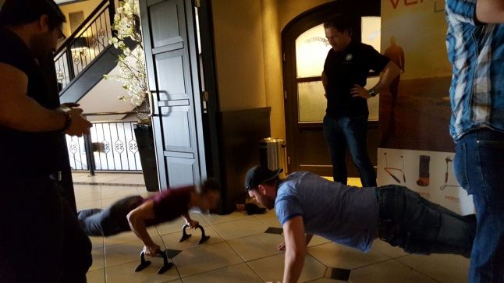
MSH Activation
TOP 15
Activity
Free Display
Training sales staff
Facebook / Twitter to promote activity
1 day Demonstration – Price Verve Ones - MINI
Free Demo + cleaning set (cred)
First shipment 15th of June
Min order:
8 Verve Ones
6 Verve Ones +
6 Verve Rider
6 Verve Rider +
8 Verve Loop +
Incentive – Best selling store can win a Bootcamp!

Slide 3
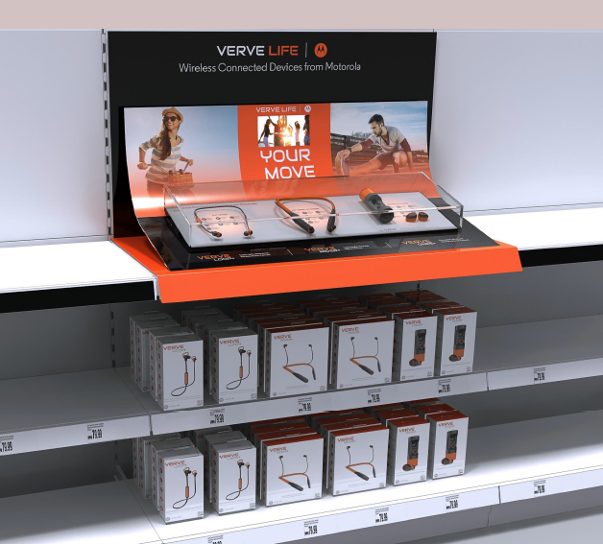
Display

Slide 4
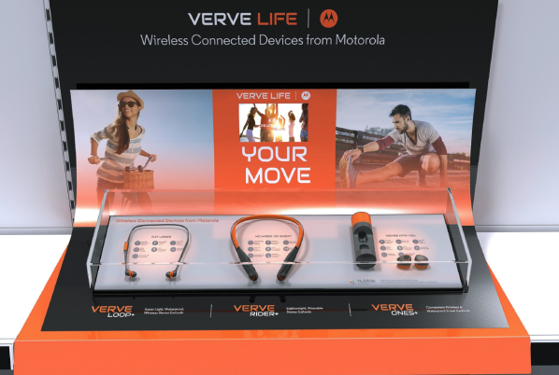
Display

Slide 5
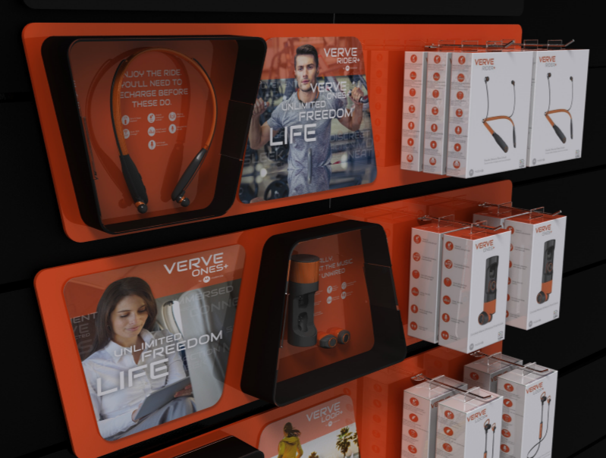
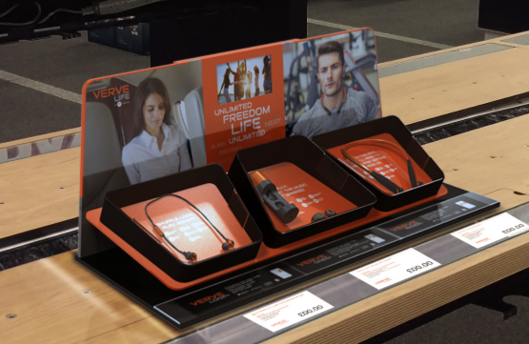
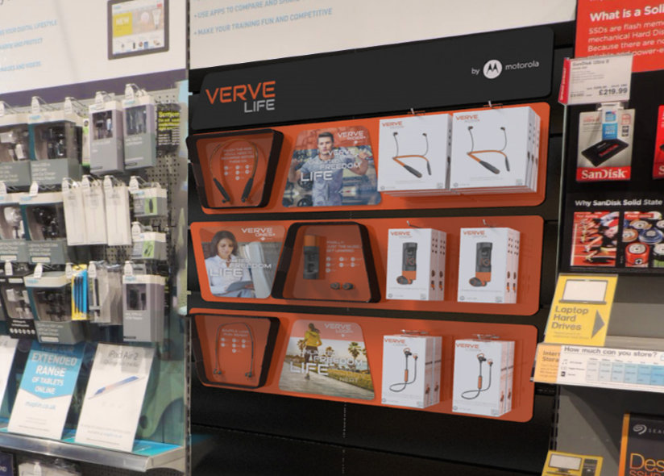
Single Display

Slide 6
Product information Verve Ones

Slide 7
Product information Verve Rider

Slide 8
Product information Verve Loop

Slide 10
Distributed by Elmarc

Slide 11
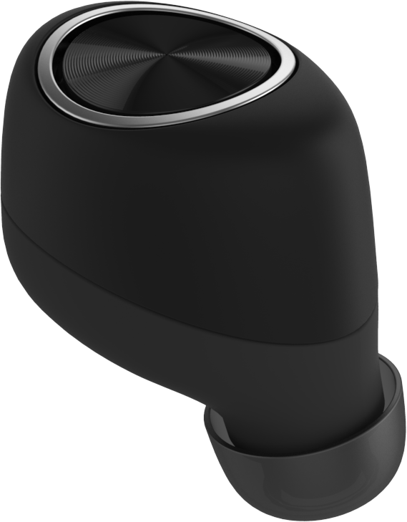
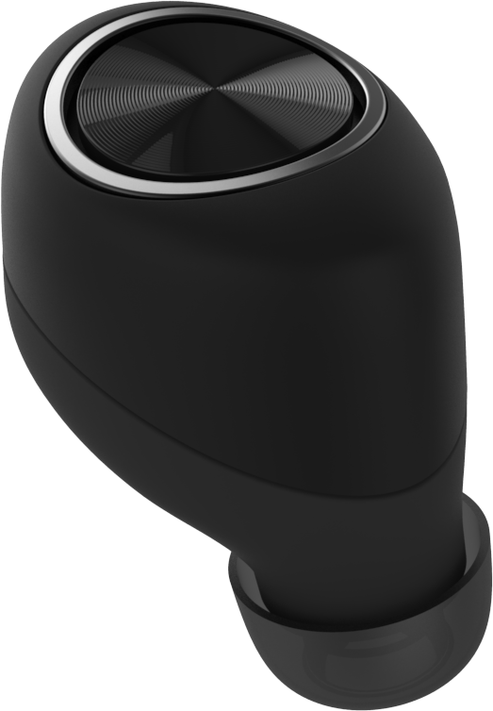
Wire Free,
Great Performance
Stunning Design
Great Fit
Everyday
Durability
(Sweat, Water Proof when it matters)
Always connected

Slide 12
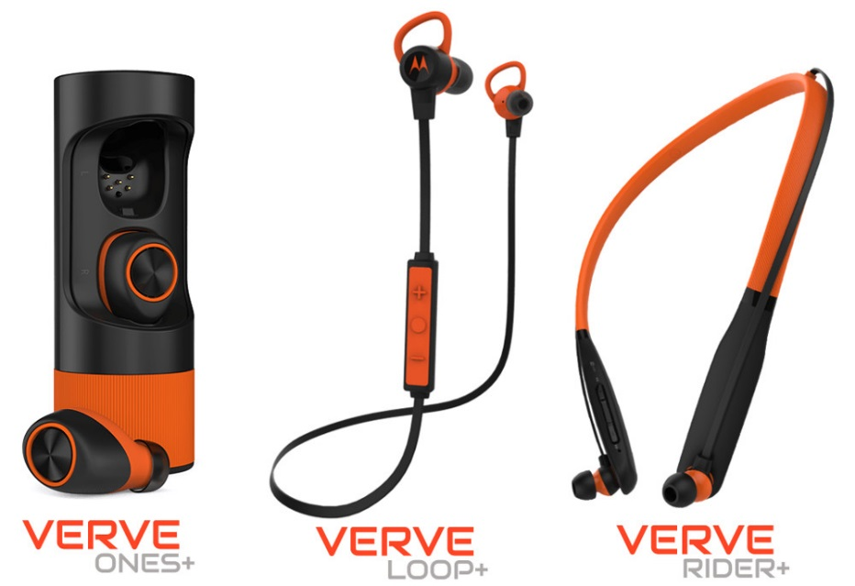
THE NEXT STEP IN Sports music
Minimum of 12 hours playtime
Sweat / Waterproof
Mic intergrated
Hubble Compatible

Slide 13
Target group
Connected listeners
Male / Female
Age 18 - 35
Active lifestyle
Above normal interest in Sports
Love streaming music and apps on their smartphone
Headphones are carefully chosen

Slide 14
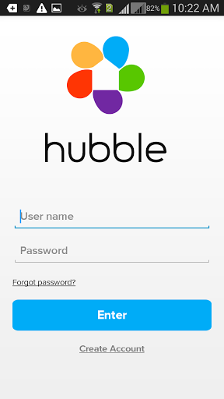
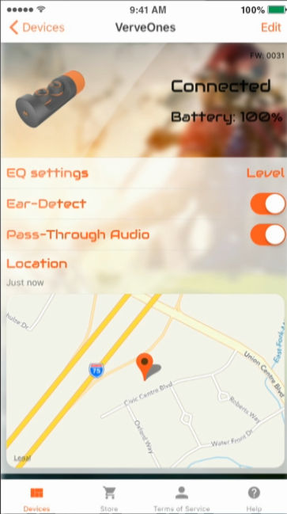
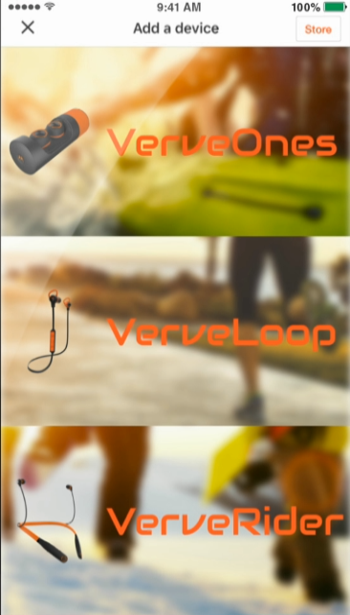
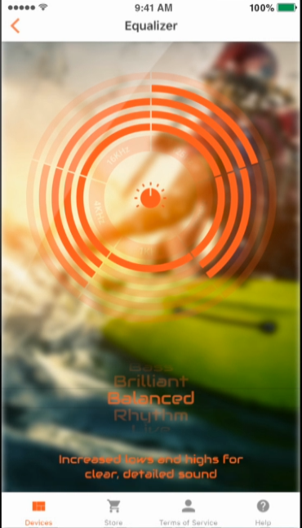
Hubble Connected
Equalizer
Ear detection
Pass-through Audio
Find your lost headset
Save your favorite settings

Slide 15
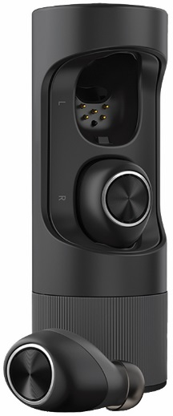
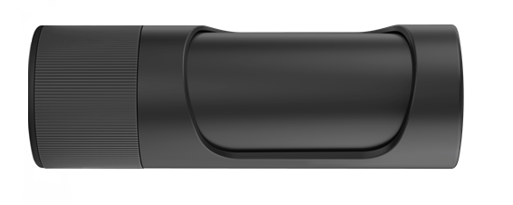
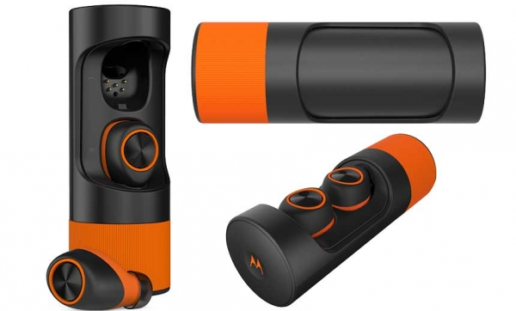
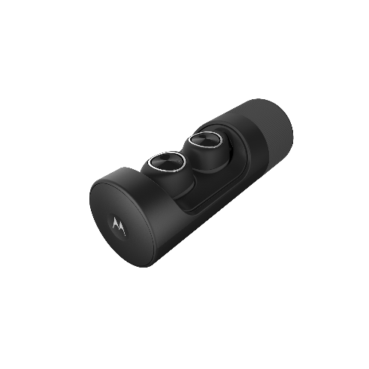
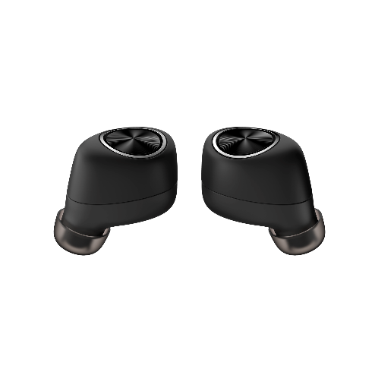
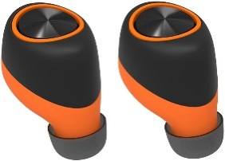
Verve Ones
Unique quality, Completely wireless Earbuds
3.5 hours playtime
Powerbank with total system time of 12 hours
15 min Charging: 1 hour playtime
App connected
Integrated dual 2 mic for clear voice calls
Verve Ones+
Same specs as the Verve Ones plus:
IP57 Water / Sweat proof
Sportcarry case
RRP €199,99
RRP €249,99

Slide 16
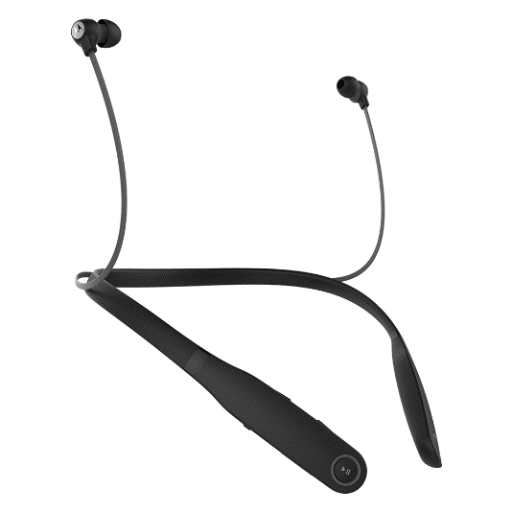
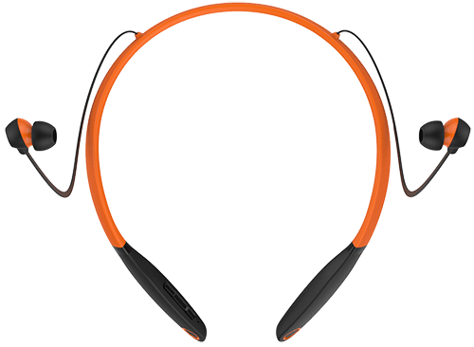
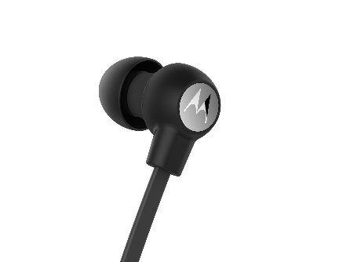
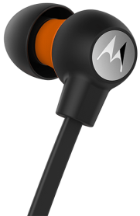
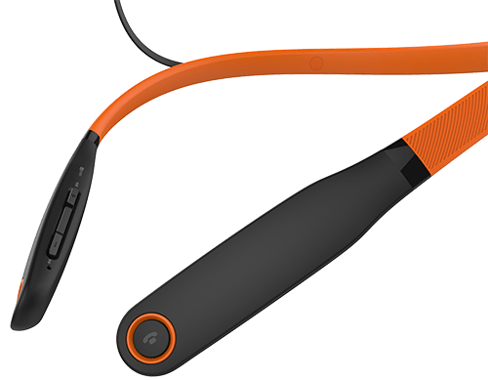
Verve Rider
Neckbud headphones for all day comfort
12 hours playtime, 15 hours talktime
IPx4 water / Sweat resistant
Vibrate notifications
Integrated Mic
Integrated remote control
App connected
Verve Rider+
Same specs as the Verve Rider plus:
IP57 Water / Sweat proof
4 extra ear gels for a total of 8 to get a perfect fit
Sportcarry case
RRP €79,99
RRP €99,99

Slide 17
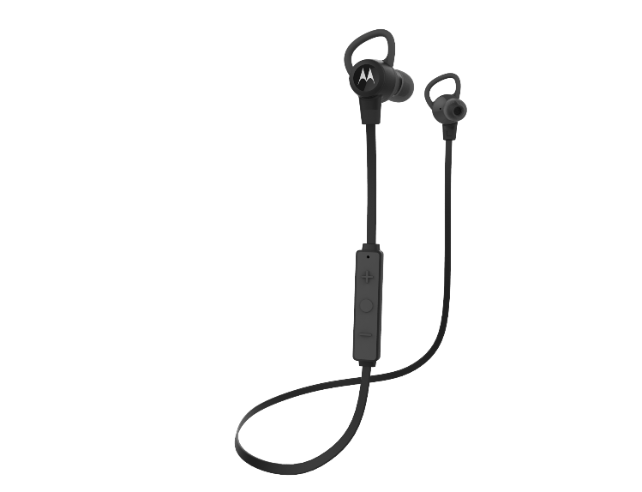
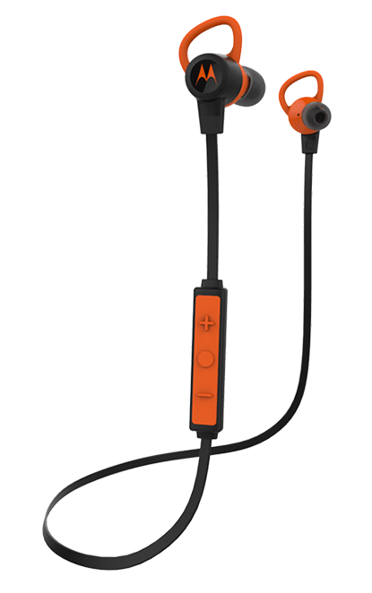
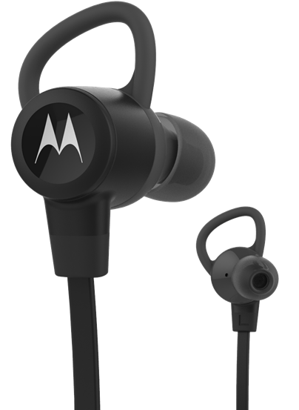
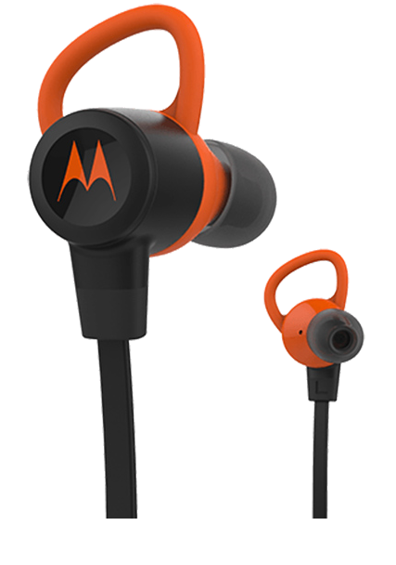
Verve Loop
Superlight, wireless Earbuds for high impact activties.
6 hours of Playtime
IPx4 water / Sweat resistant
3 ear gels + 2 stabilisers
Integrated mic, noise echo cancellation
Integrated remote control
App connected
Verve Loop+
Same specs as the Verve Rider plus:
IPx7 Water / Sweat proof
12 Hours battery life
4 ear gels + 3 stabilisers
Sportcarry case
RRP €69,99
RRP €89,99

Slide 18
Enjoy life less seriously
Verve Ones
Completely WIRELESS
Sweat / Waterproof
THANK YOU!
UNLIMITED
The NEXT step in
FREEDOM
Sports Music
LIFE
Connected

