Slide 1
VERVE
LIFE
ENJOY LIFE,
LESS SERIOUSLY
www.verve.life
by motorola

Slide 3
HOW TO PAIR
Remove Both Headsets and place in ears
Note that there is a left and right headset
Shipping Units will be marked, current samples are not
Pair Ones to phones as any other headset
After initial pairing simple remove from case and place in ears and units will pair to phone
The left headset is master and can be used as a mono headsets. The right headset can not be used standalone
Left headset is left channel, Right headset is right Channel

Slide 4
CONTROLS
HOW TO USE
POWER On/Off
- Remove and replace headset to case
Volume
- Volume is controlled from Phone
MFB Button
When Music is playing
Press once for Play/Pause
Press Twice for Track Forward
Press Three times for Track Backward
Press and Hold for EQ change
For incoming call press the MFB once to answer
When no Music player active Long press will Enter Voice Services

Slide 5
The IOS and ANDRIOD Application
Features
-See where Headset was last
located
-Turn on/off pass through audio
-Turn on/off in-ear detect
-Adjust EQ settings
-Music/Video mode (advanced settings)
- VP Language selection (next page)
- Help and proper fitting information
guides
-Upgrade software OTA - (Coming, not at launch)

Slide 6
App Continued
Notes
To pair to App place headsets in case and search from App.
App will find and pair
App can only make changes to the headset when it is in the case
App will tell user to put headsets in case to make changes
Language selection
Group One
UK English
Chinese Simplified
Japanese
Group two
UK English
US English
French Canadian
Spanish
German
Italian
EU French

Slide 7
Known Issues With Ones Samples
Note that there is a left and right headset and the will be marked
Shipping Units will be marked, current samples are not
QSG that shipped with Samples have a Setting menu
Setting menu has been removed
SW in the sample units shipped is acceptable to leave with customers
If time allows please send samples back to HK or Atlanta Office and we will upgrade to latest SW version and return

Slide 8
TRUE-WIRELESS COMPETITIVE SET
VerveOnes+
VerveOnes
EARIN
Dash
$ 299
$ 249
$249
$ 299
Launch Timing | Q2 2016 | Q2 2016 | Released | Limited Release
Driver | SINGLE DYNAMIC | SINGLE Dynamic | SINGLE B.A | SINGLE B.A
Noise Control | 2 MIC NREC | 2 mic NREC | NA | 1 MIC
Charge Case | YES | YES | YES | YES
Gels | 6 GELS | 6 GELS | 6 GELS | 3 Fit Sleeves
Playtime Headset | 3.5 HOURS | 3.5 Hours | 2.5 Hours | 3 -4 HOURS
Total Time | 12 HOURS | 12 HOURS | 8 HOURS | Unknown
Water Protection | IP57 | NA | < IPx4 | IPx7 (SWIM-ABLE)
Pass Thru Audio | YES | YES | NO | YES
Sensors | IR | IR | NO | CARDIO, OXY, TEMP
Application | YES | YES | NO | YES
Onboard Track Ctrl | YES | YES | NO | YES

Slide 9
Headset Comparisons with iPhone 6+
Range and pocket testing
 | Iphone 6+ (OS 9.3) |  |  |  | Pocket Test Outside
BT Headset | Local Play | Youtube Play | Iphone6+ range(m) | Iphone6+ range(ft) | Left-front | Right-front | Left-rear | Right-rear | Pants Fit
Verve Ones | 0.189 | 0.187 | 26 | 85 | Pass | Pass | Pass | Pass | Fitted
Earin | 0.245 | 0.293 | 20 | 64 | Pass | Pass | Pass | Skip | Fitted
Dash - Bragi | 0.520 | 0.113 | 8 | 25 | Pass | Skip | Skip | Skip | Fitted
fFLAT5 - Aria | 0.278 | 0.283 | 16 | 53 | Skip | Skip | Skip | Skip | Fitted
Jaybird X2 | 0.029 | 0.059 | 63 | 208 | Pass | Pass | Pass | Pass | Fitted
Power Beats Wireless | 0.013 | 0.023 | 24 | 78 | Pass | Pass | Pass | Pass | Fitted
VerveOnes has best range performance amongst tru-wireless stereo headsets.
Audio Drops in Slave headset

Slide 10
Bragi Reviews
1.0 out of 5 starsAvoid until they get the bugs out of the hardware, software and their support practices.
ByMr. Cheetoduston April 8, 2016
Color: Black
I supported the kickstarter for these in hopes that they would deliver what was promised. After numerous missed dates and delays (a little more than a 1 year delay from initial kickstarter stated dates to be more specific) I finally received my unit. I followed the direction charged, paired and wow nothing! I reached out to them via email and after a 7 day delay they responded reset the unit. I responded I already did and 6 or 7 days later they responded reload the units software. Well that's the problem no way to load software on something that no longer turns on. So the immediate action by me with 6-7 day delayed response by them ends with the final blow I have to ship to them at my cost for repair or replacement.
Top positive review
See all 5 positive reviews›
4.0 out of 5 starsGreat build quality
ByHeathon April 8, 2016
Great build quality, pleasant sound and decent battery life(3 to 4 hours without the case). The dash is the perfect headphones for urban commute. The only down side is the limitation of Bluetooth technology. The music skips every time I'm in an open, windy space even if my phone is in the right pocket. Despite the occasional drop-outs, the dash is a futuristic product that works.
Amazon
4.4 out of 5
6 reviews total
App
3.5 out of 5 star(89 reviews)
They update frequently
Sams Club
No reviews yet

Slide 11
Earin Reviews
Amazon
2.6 out of 5
39 reviews total
BEST BUY
3.3 out of 5
123 reviews
APP
2.5 out of 5
11 reviews

Slide 12
Videos
Waterproof: https://app.box.com/s/ih8wpe3vduknll0l4nnf09znjjwi0qvy
Ones Use: https://app.box.com/s/7uvkyxqi6avxmefcb7umo1kt7rqlploz
Ones Fit: https://app.box.com/s/nsbpoykls9cwvomci9ztbccxqcq8awof

Slide 14
TRUE-WIRELESS COMPETITIVE SET
VerveRider+
VerveRider
LG Tone Pro HBS 760
LG Tone Active HBS-850
$ 99
$ 79
$69
$ 129
Launch Timing | Q2 2016 | Q2 2016 | Released | Released
Driver | SINGLE DYNAMIC | SINGLE Dynamic | SINGLE Dynamic | SINGLE Dynamic
Aptx | YES | YES | YES | YES
App Support | YES (IOS and Android) | YES(IOS and Android) | YES (Android) | YES (Android)
EQ Controls | YES | YES | YES | YES
Playtime Headset | 12 HOURS | 12 Hours | 10.5 Hours | 9.5 Hours
Stby Time | 31 Days | 31 Days | 23 Days | 18 Days
Vibration Notification | YES | YES | YES | YES
Water/Sweat Proof | YES IPX7 | NO | NO | NO IPx3
Voice Prompts | YES | YES | YES | YES
Range | 150 ft | 150ft | 33ft | 33ft
Onboard Track Ctrl | YES | YES | YES | YES

Slide 15
Video
Rider Use: https://app.box.com/s/294p618tqk2k5lu3ghyunuy4clasmesu
Rider Fit: https://app.box.com/s/dkbyipptytf95ij10n2a42qwdkmt62v6

Slide 17
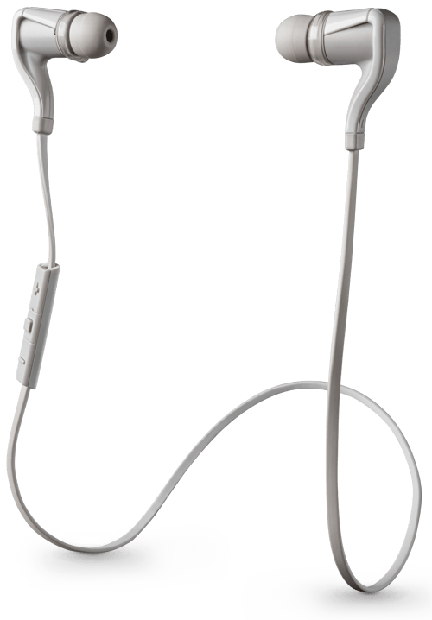
TRUE-WIRELESS COMPETITIVE SET
VerveLoop+
Plantronics Backbeat Go 2
Jaybird X2
Beats By DRE
$ 79
$ 79
$179
$ 199
Launch Timing | Q2 2016 | Released | Released | Released
Driver | SINGLE Dynamic | SINGLE Dynamic | SINGLE Dynamic | Dual Drivers
Aptx | YES | no | YES | YES
App Support | YES (IOS and Android) | NO | YES (Android) | YES (Android)
EQ Controls | YES | YES | YES | YES
Playtime Headset | 9.5 HOURS | 4.5 Hours | 8 Hours | 6 Hours
Stby Time | 31 Days | 31 Days | 23 Days | 18 Days
Water/Sweat Proof | YES IPX7 | Resistant P2i | YES | Resistant IPx4
Voice Prompts | YES | YES | YES | YES
Range | 150 ft | 150ft | 33ft | 30ft
Onboard Track Ctrl | YES | YES | YES | YES

Slide 18
videos
Loop Fit: https://app.box.com/s/d4wpju2xj7qf8p3ms89fweik9cg7lc62
Loop Use: https://app.box.com/s/7b7x3xqqxaf7czyb1g1hmj7pvrhdv1by

