Slide 2
Distributed by Elmarc

Slide 3
Target group
Connected listeners
Male / Female
Age 18 - 35
Active lifestyle
Above normal interest in Sports
Love streaming music and apps on their smartphone
Headphones are carefully chosen

Slide 4
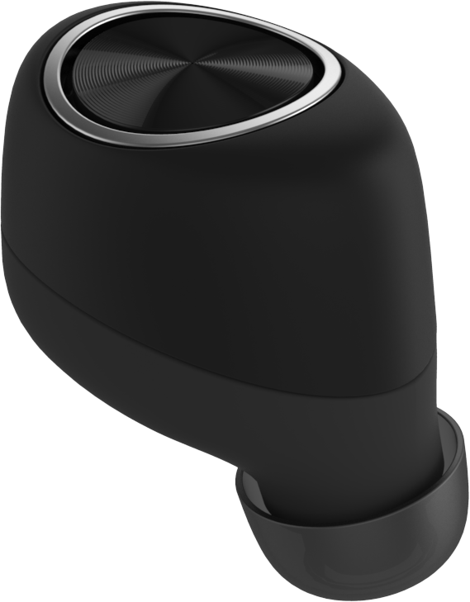
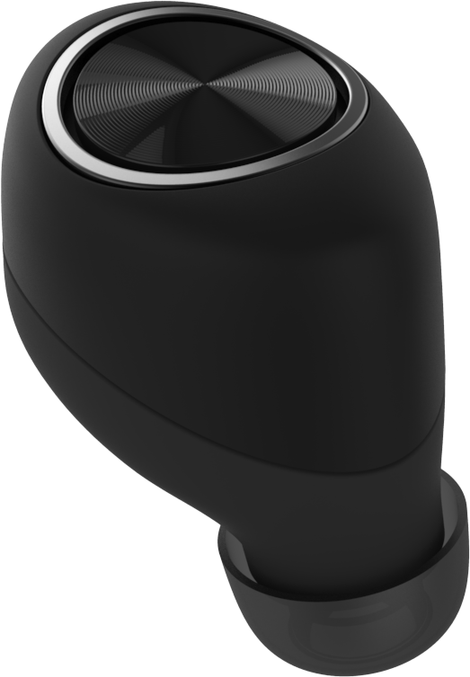
Wire Free,
Great Performance
Stunning Design
Great Fit
Everyday
Durability
(Sweat, Water Proof)
Always connected

Slide 5
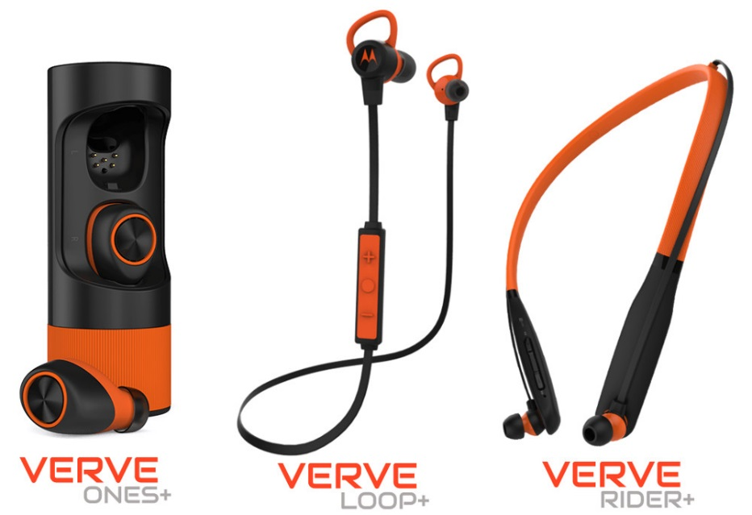
THE NEXT STEP IN Sports music
Minimum of 12 hours playtime
Sweat / Waterproof
Mic intergrated
Hubble Compatible

Slide 6
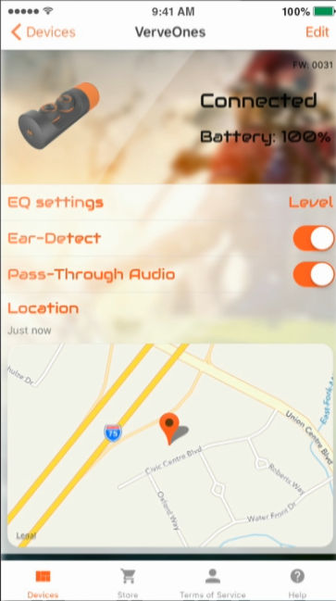
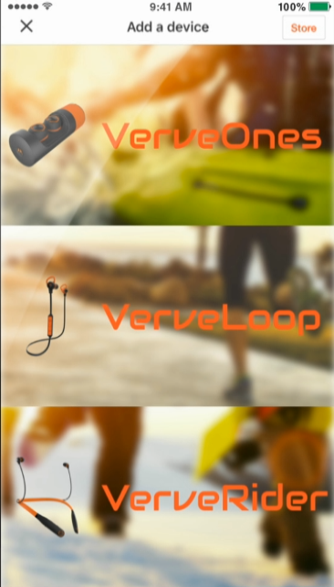
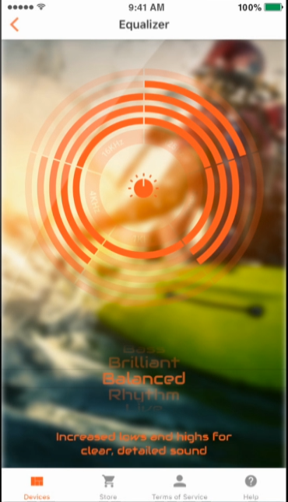
Hubble Connected
Equalizer
Ear detection
Pass-through Audio
Find your lost headset
Save your favorite settings

Slide 7
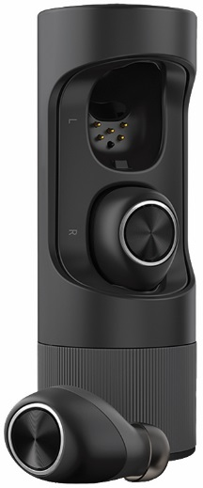
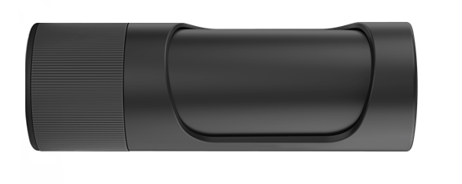
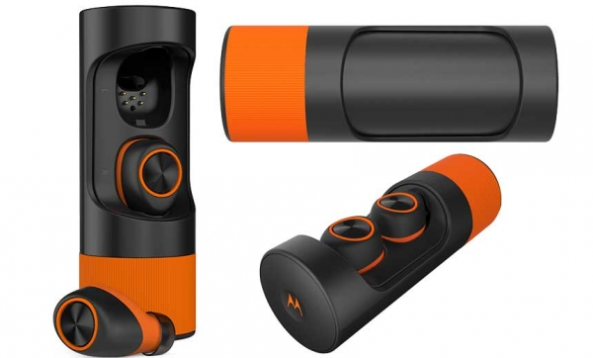
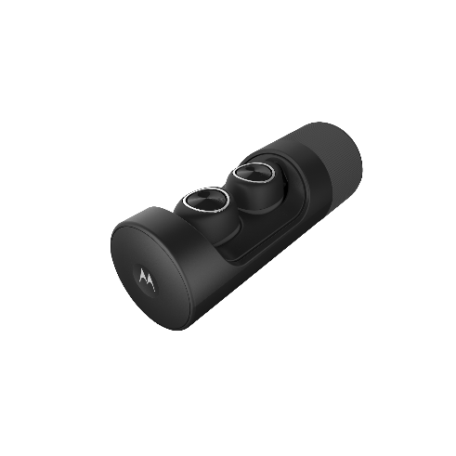
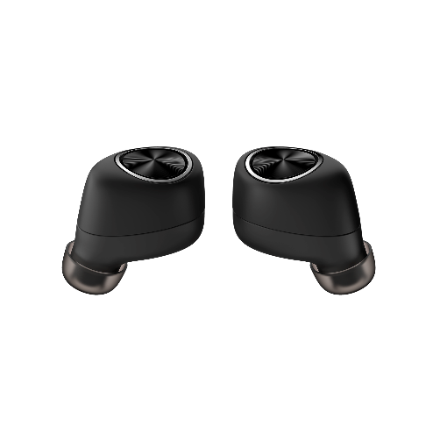
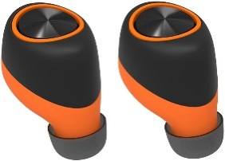
Verve Ones
Unique quality, Completely wireless Earbuds
3.5 hours playtime
Powerbank with total system time of 12 hours
15 min Charging: 1 hour playtime
App connected
Integrated dual 2 mic for clear voice calls
Verve Ones+
IP57 Water / Sweat proof
Sportcarry case
RRP €199,99
RRP €249,99

Slide 8
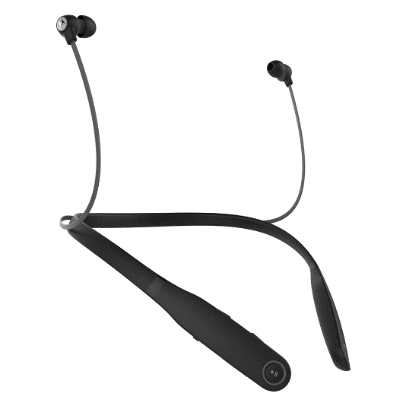
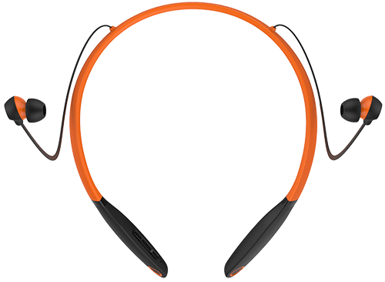
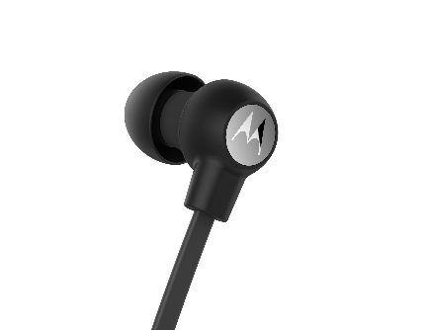
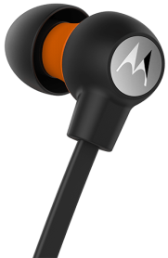
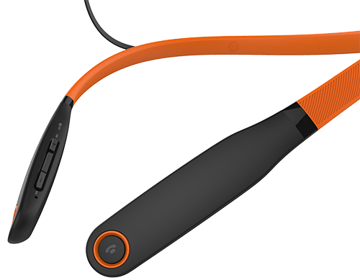
Verve Rider
Neckbud headphones for all day comfort
12 hours playtime, 15 hours talktime
IPx4 water / Sweat resistant
Vibrate notifications
Integrated Mic
Integrated remote control
App connected
Verve Rider+
IP57 Water / Sweat proof
4 extra ear gels for a total of 8 to get a perfect fit
Sportcarry case
RRP €79,99
RRP €99,99

Slide 9
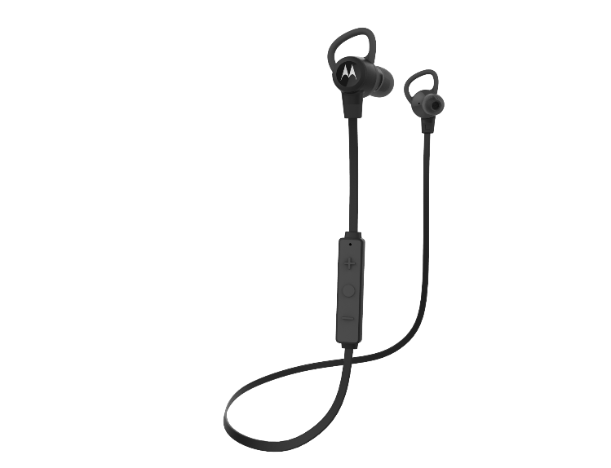
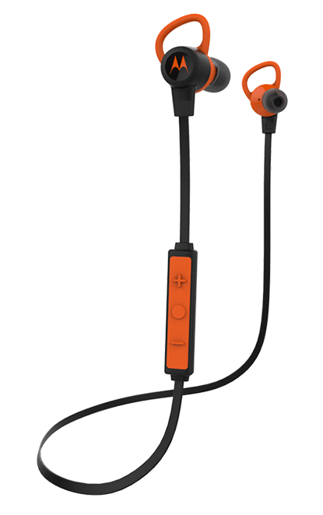
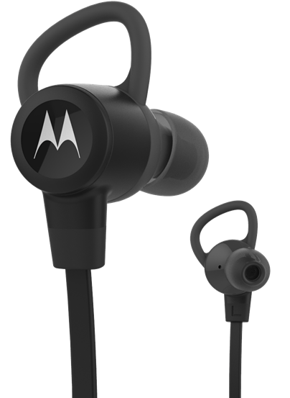
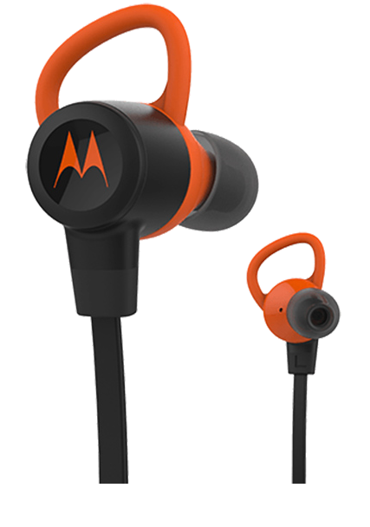
Verve Loop
Superlight, wireless Earbuds for high impact activties.
6 hours of Playtime
IPx4 water / Sweat resistant
3 ear gels + 2 stabilisers
Integrated mic, noise echo cancellation
Integrated remote control
App connected
Verve Loop+
IPx7 Water / Sweat proof
12 Hours battery life
4 ear gels + 3 stabilisers
Sportcarry case
RRP €69,99
RRP €89,99

Slide 10
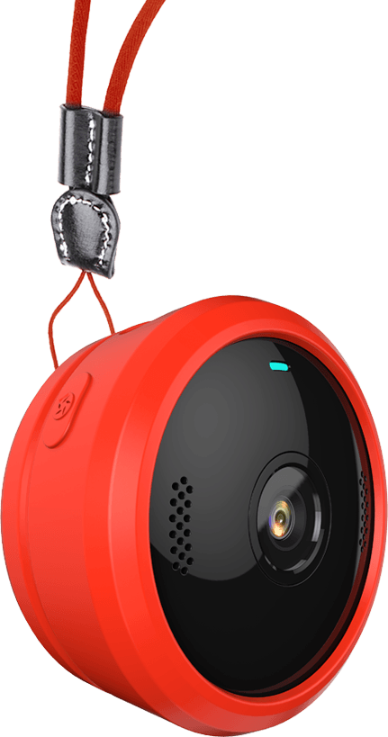
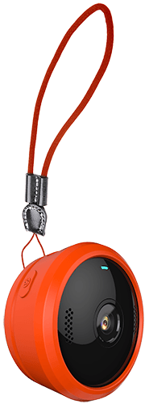
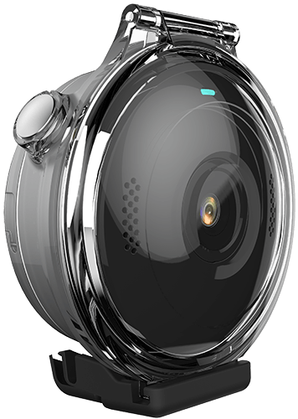
RRP €199,99
Verve Cam
Ultra portable Lifestyle Video Camera
Brilliant motion video with 2.5K at 30 fps and 138° field of view
Live video streaming to Hubble Cloud and YouTube with integrated Wi-Fi
Ideal Vlogging Camera
Free VerveCam app with photo/video editing and social sharing
Social video formats including photos, time lapse, loops, slow motion and cinematic trailers
Take it 30m deep with the included IP67 water proof sports case
Multiple accessories included for every activity

Slide 11
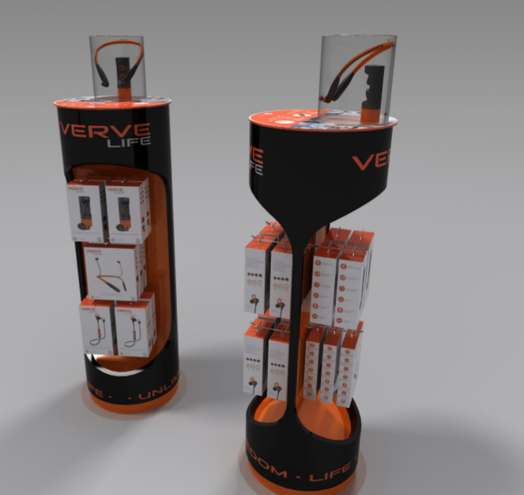
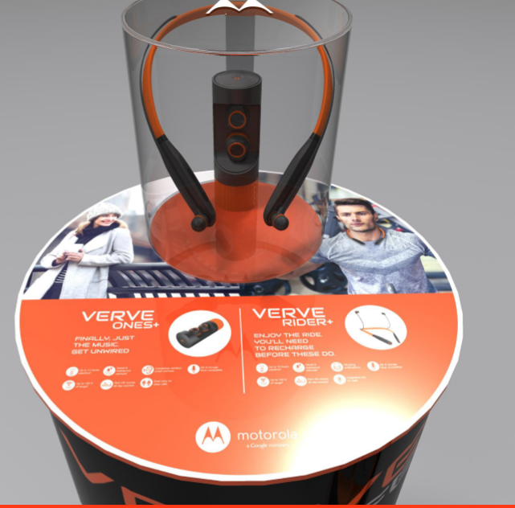
POS CONCEPT

Slide 12
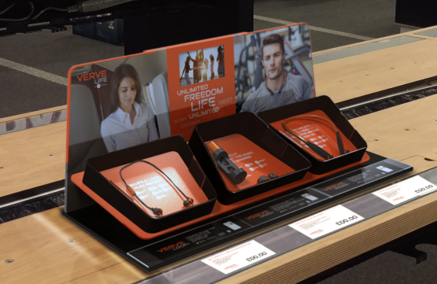
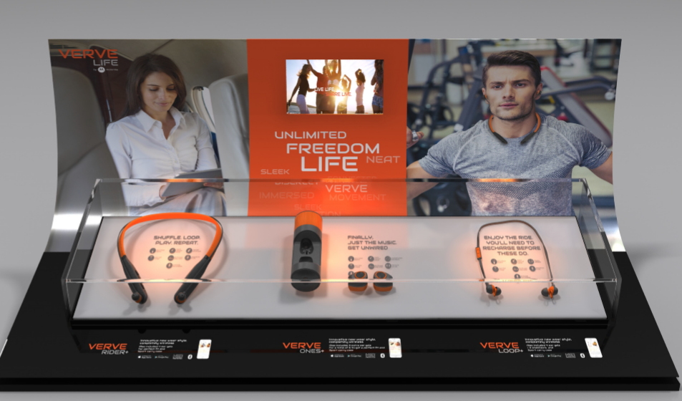
POS CONCEPT

Slide 13
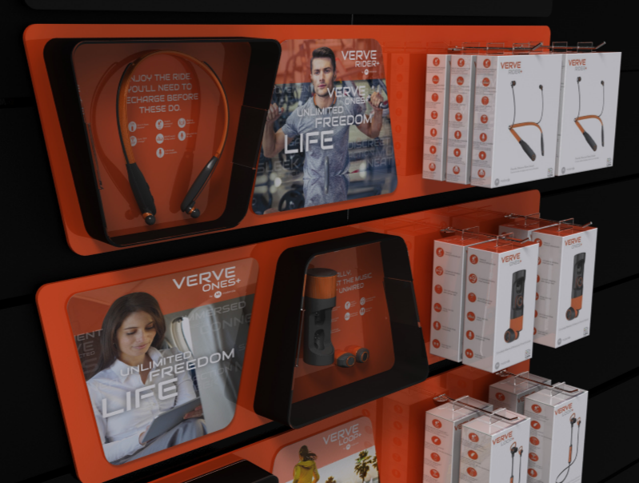
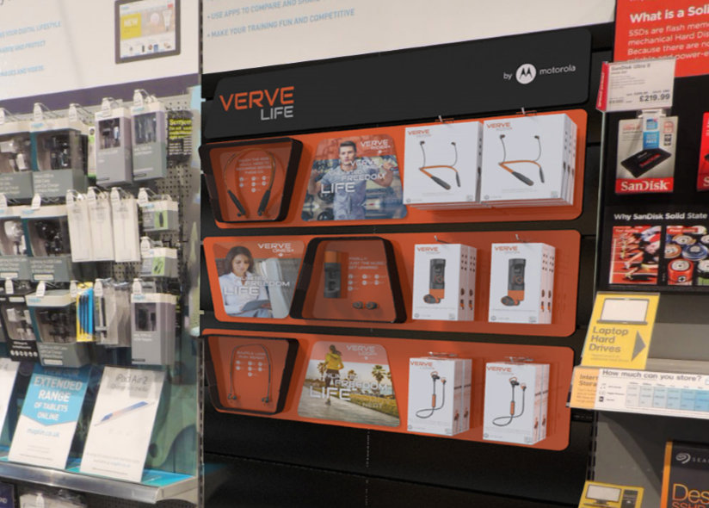
POS CONCEPT

Slide 14
Graag dagen we je uit om de Verve Life producten te komen testen!

Slide 15
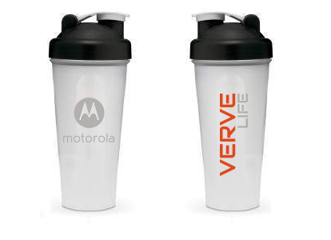
Als prijs een sportieve professionele drinkbeker bij 15x opdrukken!

Slide 16
Verve Ones
Enjoy life less seriously
Completely WIRELESS
The NEXT step in
THANK YOU!
Sports Music
UNLIMITED
FREEDOM
Sweat / Waterproof
LIFE
Connected

